Slide 1
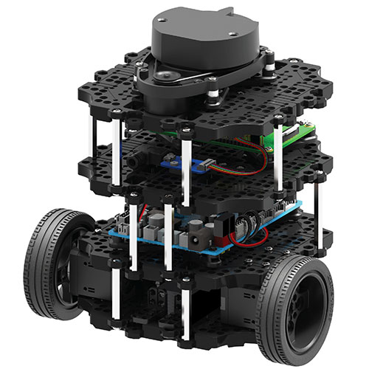
PROJECT REVIEW-1 WALL FOLLOWING
TEAM 05
SRIJIT DATTA | PPT & Documentation
ALAN YANG | Programmer
ANIRUDH KYATHAM | Presenter
KRISHNA SAI NAGINENI | Program manager

Slide 2
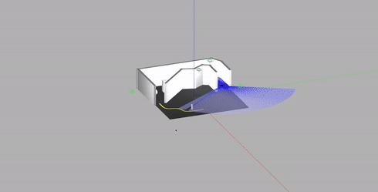
OBJECTIVE
In the world provided in Gazebo, feed the turtle bot a constant velocity, while avoiding collision with the walls.
A ‘PID’ controller can be implemented to maintain equal distances from each face of the wall or follow a single face while maintaining a fixed (threshold) distance from it.

Slide 3
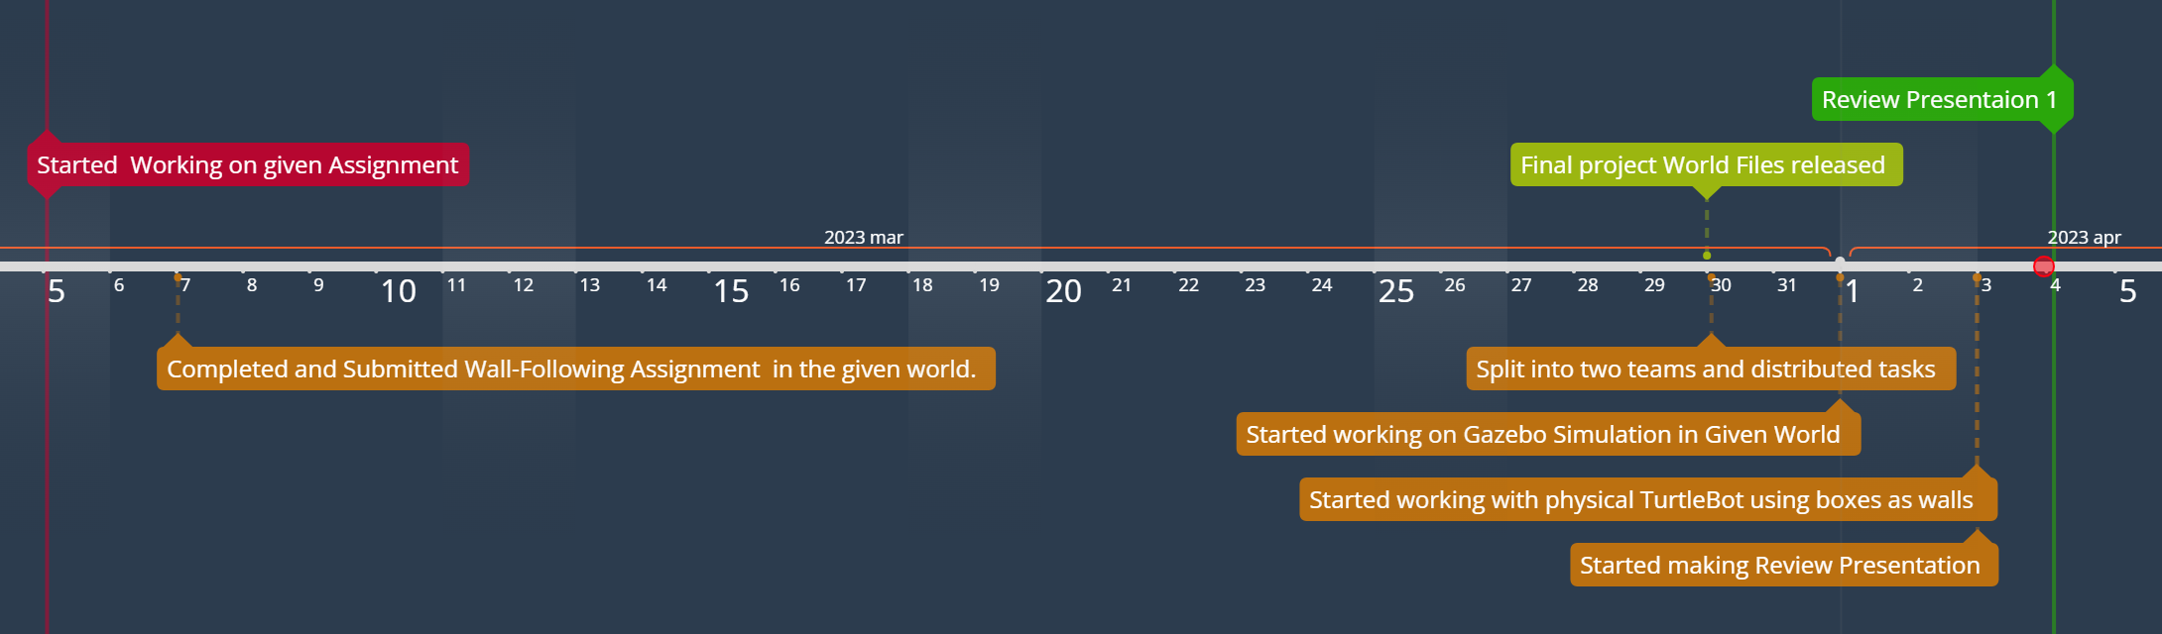
TIMELINE

Slide 4
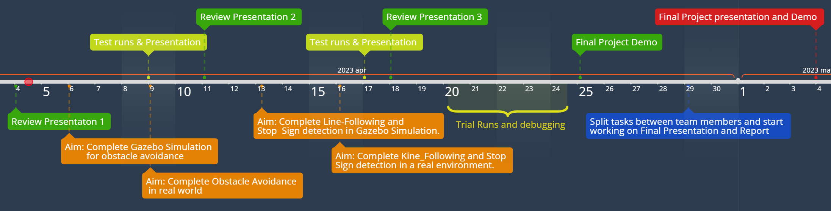
FUTURE TIMELINE

Slide 5
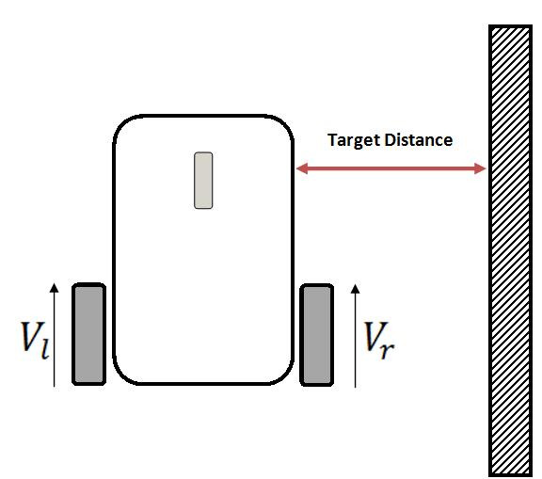
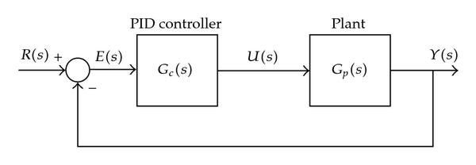
APPROACH
The wall_following.py Python script in the wall-following package implements the wall-following behavior.
The script subscribes to the scan topic in order to obtain range data from the robot's laser scanner.
A PID controller is used to control the robot’s motion by taking /scanning data as input from the left and right sides of the turtle bot. The value of proportional gain is taken as 0.9 and is used in conjunction with a linear velocity of 0.2.
The error is estimated by scanning and subtracting left data from right data and the error is fed to the PID controller, which helped correct the angular velocity.
The robot moves in the direction with the greatest mean range value (i.e., the sector with the most open space).
https://iamzxlee.wordpress.com/2014/06/21/wall-following-robot/

Slide 6
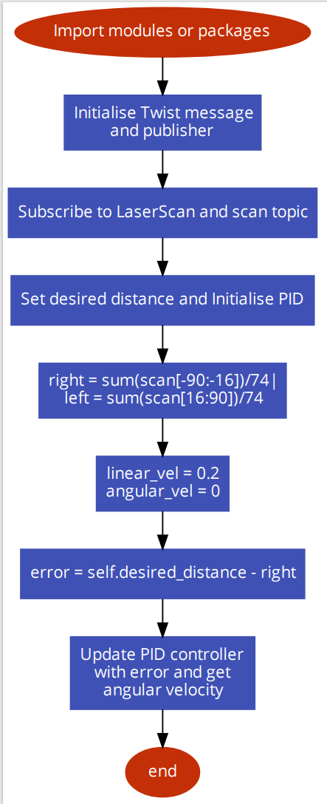
FLOWCHART:

Slide 7
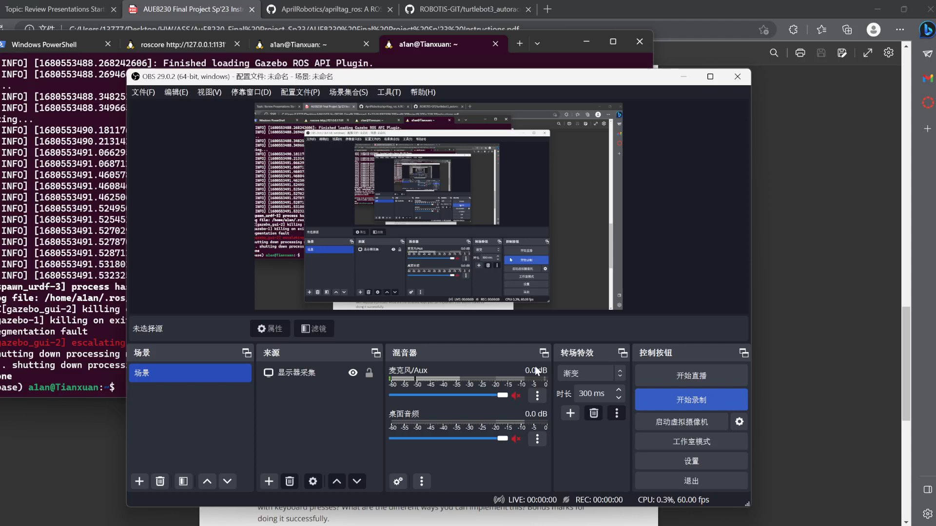
SIMULATION IN GAZEBO
$ roslaunch aue_finals wall_follower.launch

Slide 8
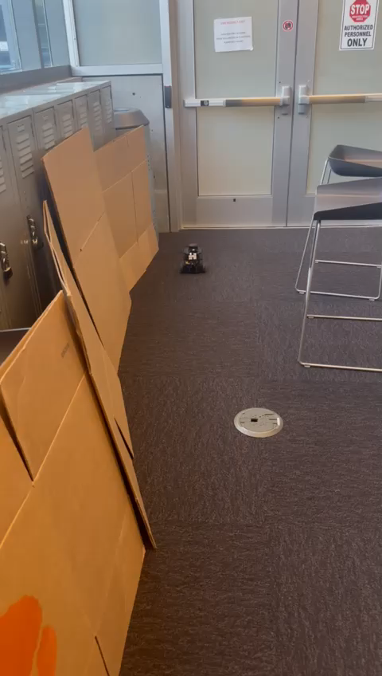
REAL WORLD
We attempted to create an environment similar to the provided world in Gazebo in the real world by using Cardboard boxes supported with chairs.
An approach similar to the one used to work in the Gazebo simulation was used to work in the real environment as well.
The linear velocity was taken as 0.2 and the value of the proportional gain is taken as 1.5
$ rosrun aue_finals wall_following.py

Slide 9
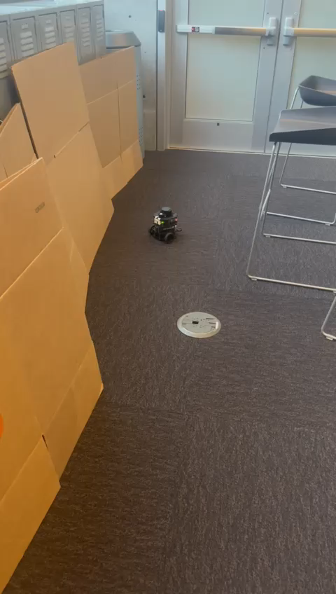
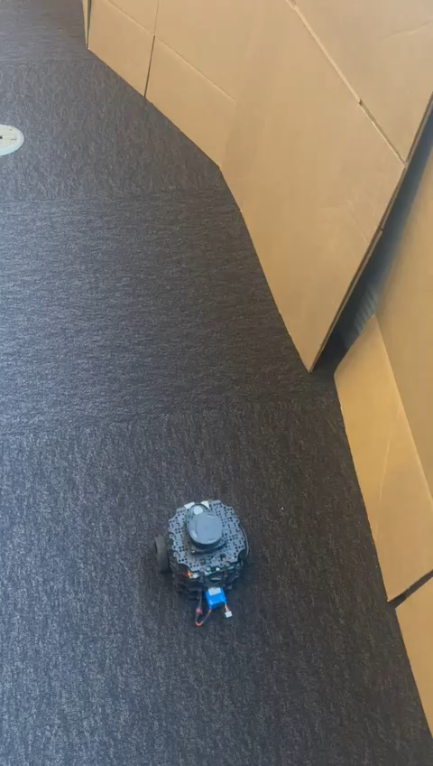
CHALLENGES FACED & FUTURE SCOPE
Initially, an open loop was used, but this resulted in arbitrary motion of the TurtleBot’s numerous collisions with the wall. Integrating a P controller was a much easier approach and with a little tuning, the TurtleBot moved in a satisfactory manner.
The value of proportional gain which was working for the simulation in the Gazebo environment was not optimal when working with the physical TurtleBot in the real world. Hence, further tuning was required to make the TurtleBot move with a constant velocity while trying to maintain a uniform distance from the walls.
Having a Derivative gain would further improve the trajectory of the TurtleBot.

Slide 10
PROGRESS & NEXT STEPS
We are up to date with every Assignment given.
All the codes, Readme files, videos, and screenshots are uploaded on GitHub.
All hardware on the TurtleBot is working fine.
The next step would be to start working towards Task 2 – Obstacle Avoidance.
Assigning roles to team members and splitting the tasks.
Tweak the existing code (submitted for the Assignment) so that it works in the world given for the final project as well as in the real world.
Documenting the challenges faced and searching for solutions for the same during test runs in Simulation and in real environments.

Slide 11
THANK YOU

